Slide 1
Unit-2 Program/Software Development
Er. Bhisma Raj Joshi
Department of Computer Engineering
( NAST )

Slide 2
Objectives
Introduction to program/software development
Program Development Life Cycle.
Problem Identification, Problem Analysis/Requirement Analysis
Problem Design Phase, Program Coding or system development
Program Testing, Debugging and Validation, Program Delivery/Implementation
Program Maintenance, Documentation
Basic Programming Tools
Example 1. Algorithm
2. Flowchart
3. Decision Table and Decision Tree
4. Pseudocode
Comparison of Programming Tools adv & dis-adv

Slide 3
Exam Point of View
2 LQ – 7 and 8 marks = 15
1 Short Notes = 5

Slide 4
# Program and Program Development
A program is a set of instructions written in a programming language that a computer can execute to perform a specific task or solve a problem. It translates human intentions into machine-readable code.
Program development involves a systematic sequence of steps, including problem analysis, design, coding, testing, and maintenance for creating functional software.
It includes iterative cycles of developing, testing, and refining the software to ensure it meets user requirements and is free of errors.

Slide 5
Program Development Life Cycle
It is also known as Software Development Life Cycle(SDLC).
It is the process used by software company or industry to design, develop and test the high-quality software product.
It is a framework that define different tasks which are performed during software development process.
It consists of several steps which are shown in fig below.

Slide 6
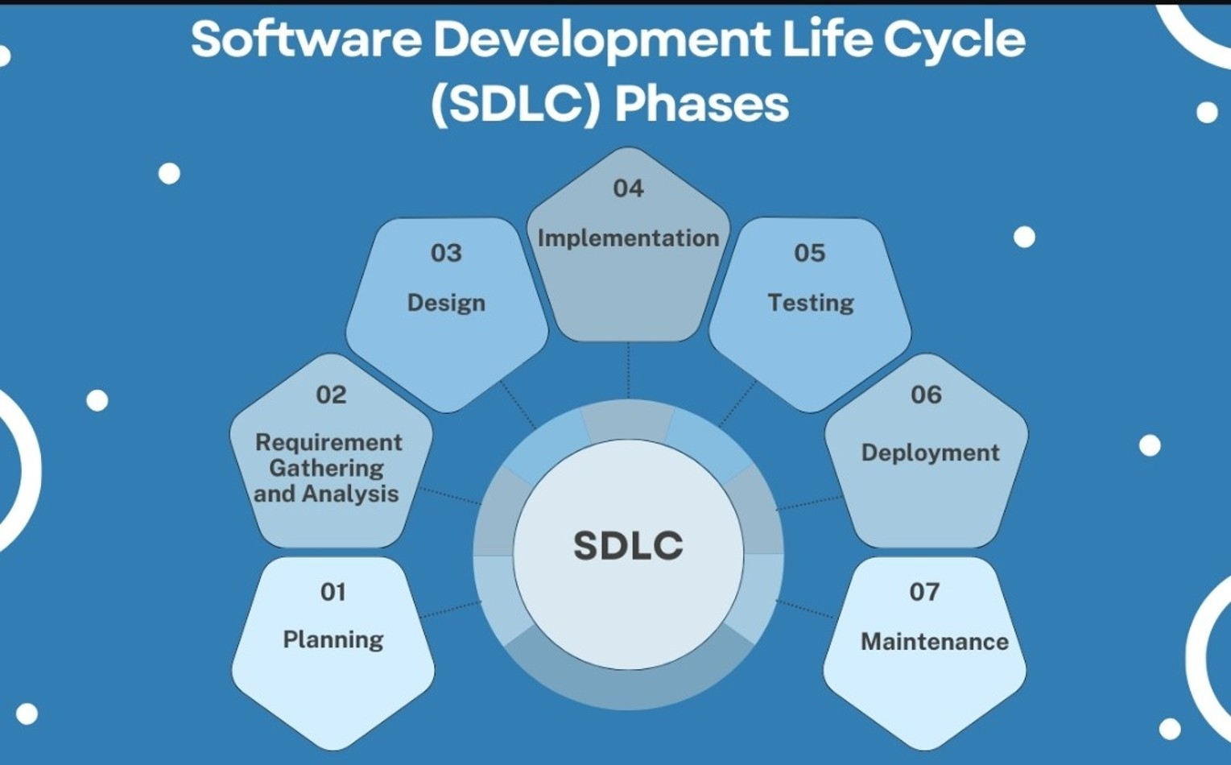
Fig:- Software Development Life Cycle
OR
Coding
and data
validation
Problem Identification
And
Documentation

Slide 7
1. Problem Identification
The problem identification phase is a critical initial step in the Software Development Life Cycle (SDLC). It involves understanding the problem or opportunity that the software solution is expected to address.
The key points of problem identification phase are..
i) Understanding the Problem: Gather detailed requirements and insights from
stakeholders to clearly understand the problem that needs to be solved.
ii) Analyzing the Problem: It involves identifying the main issue, determining what factors contribute to it, and figuring out the requirements for solving it. Essentially, it's about gaining a clear and complete understanding of the problem before deciding on a solution.

Slide 8
2. Requirement Gathering and Analysis
The requirement gathering phase is all about collecting information from various sources to understand what the stakeholders need from the system.
The various techniques for gathering requirements are
Interviews: Conduct one-on-one/group interviews with stakeholders to
gather in-depth insights.
Surveys: Use structured surveys to collect information from a larger
audience.
Workshops: Organize collaborative workshops to discuss requirements
and brainstorm solutions.
Observation: Observe users in their natural environment to understand
how they interact with current systems.
Document Analysis: Review existing documentation, such as business
plans and user manuals, to extract relevant information.

Slide 9
Once the requirements are gathered, the next step is to analyze them to ensure they are clear, complete, and feasible.
The feasibility study analyzed the proposed system from different aspects so that the development team or company can conclude how practical or beneficial the system will be to the organization.
The different levels of feasibility study includes
Economic feasibility
Technical feasibility
Operational feasibility
Schedule feasibility
Legal feasibility

Slide 10
assignment 1 Define feasibility study, what is its importance in SDLC. Explain its various types in details.

Slide 11
3) Design
- It is concerned with the design of the wireframes to illustrate how
the software will look and function. It involves designing of various
things such as input design, processing and output design etc.
- While designing a system the different system design tools are used.
some examples includes.
a)Algorithm:- It is a finite sequence of instruction for solving a problem.
b)Flowchart:- It is the pictorial representation of an algorithm.
c)ER diagram:- The entity-relationship diagram is an overall logical
structure of a database that can be expressed graphically.
d) Decision Table:- A decision table is a structured way to represent conditions
and corresponding actions in a tabular format.

Slide 12
4. Implementation or Coding
The system design needs to be implemented to make it a workable system so after the system design the programmers begin to develop the program by using a suitable high level programming language based on the design specifications created in the previous stage.
In system development the following process are done.
- Convert the logical structure into program
- Database is created
- Version control and integration
The coding phase is crucial because it directly converts plans into a functional product.

Slide 13
5. Testing and Data Validation
It is an investigation conducted to provide stakeholders with information about the quality of the product or service under test.
In this phase the testing and debugging task are performed. If any inconsistencies errors or problems are found then they are corrected by improving the individual units.
- There are 2 types of testing
Black Box testing:- Process of testing the whole project and test whether a
whole system is functioning or not.
White Box Testing:- In white box testing the particular model or unit
is tested which helps to test the software internal logic.

Slide 14
Testing is also divided into two types as:-
Alpha Testing
It is the final level of QA team’s testing to ensure that your program is ready for release outside of your organization. Its main goal is to ensure that the software is bug-free.
b) Beta Testing
In beta testing the final product or software is distributed to a small group of genuine users and users are invited to provide comments and review on the software’s performance.

Slide 15
Data Validation is the process of ensuring that data entered into a system is accurate, complete, and meets predefined criteria.
Types of Data Validation:
Format Validation: Ensures data follows a specific format (e.g., email,
phone number).
2. Range Validation: Checks if data falls within a specified range (e.g., age
between 1 and 100).
3. Consistency Validation: Verifies data across related fields (e.g., matching
password and confirm password).
4. Presence Validation: Ensures mandatory fields are not left blank.
5. Uniqueness Validation: Confirms that data entries are unique (e.g., unique
usernames).

Slide 16
6. Deployment
Once the coding and testing of the software has been completed, the next phase starts to create a complete package which is called setup file to deliver or deploy the system for the client or end users.
The software is installed in the client’s computer for the final implementation and evaluation of the system.
The major steps involve in this phase are:
Installation of hardware and software
User training
Providing instruction manuals
Review and Feedback

Slide 17
7. Maintenance and Documentation
It begins after system deployment . This is the phase that conduct the periodic maintenance of hardware and software to ensure it continue to function as it was design.
It involves fixing bugs, updating features, and optimizing performance based on user feedback or evolving requirements.
This phase ensures the software remains reliable, secure, and aligned with business needs over time.

Slide 18
The final and the last phase of the program development life cycle is the documentation phase.
In this phase a technical writer prepares a reports, project documents, contracts and agreements related with project.
It includes the overall description of the system including the reports as well as instruction manuals that ensure smooth knowledge transfer, simplifies troubleshooting and supports future enhancement.
This phase happens throughout the entire SDLC to keep all documents updated with any changes.

Slide 19
Assignment 2 why testing phase is necessary in SDLC? Write down the major differences between Testing and Debugging.

Slide 20
Assignment:3 Which phase of SDLC is more important in what context of good program design and development? Discuss with logic.

Slide 21
# Program / Software Design Tools
Software Design Tools (SDT) refer to the various tools and applications used by developers and designers to plan, create, visualize, and document software systems.
These tools help in translating concepts and requirements into concrete designs and models that guide the actual development process.
Below are the major program design tools:
1. Algorithm
2. Flowchart
3. Decision Table and Decision Tree
4. Pseudocode

Slide 22
1. Algorithm
The program design tools that contain step by step procedure or sequential steps which are written by using English language for solving specific problem.
Algorithms are written to show how a program or a function perform its calculation and data processing.
Characteristics / Features of an Algorithm
An algorithm uses finite number of logical steps.
Each step must be defined precisely and unambiguously.
Every steps should be executed exactly in finite time.
It should be independent of programming language.

Slide 23
1. Write an algorithm to add two numbers entered by users.
Step1 start
Step2 create variable num1,num2 and result
Step3 take input value from user
Step4 result=num1+num2
Step5 display the result
Step6 stop

Slide 24
2. Write an algorithm to calculate the simple interest.
Step1: START
Step2: create variable P,T,R and S.I
Step3: take value of P,T,R from user
Step4: S.I = PTR /100
Step5: display the S.I
Step6: STOP

Slide 25
3. Write an algorithm to find the area of circle.
Step1: START
Step2: Create variable r for radius
Step3: Take input value of radius (r)
Step4: Set π = 3.14
Step5: Compute Area = π × r × r
Step6: Display Area
Step7: END

Slide 26
4. Write an algorithm to find the greatest among two number. Step1: START Step2: Create variable a and b Step3: Read two numbers (a, b) Step4: IF a > b THEN display a is greatest ELSE b is greatest Step5: END

Slide 27
5. Write an algorithm to check the entered number is even or odd.
Step1: START
Step2: Create variable n
Step3: Read number (n) from user
Step4: IF n % 2 == 0 THEN
Display "Even"
ELSE
Display "Odd"
Step5: END

Slide 28
6. Write an algorithm to convert Celsius to Fahrenheit.
Step1: START
Step2: Create variable (C) to store Celsius
Step3: Read temperature in Celsius (C)
Step4: F = (C × 9/5) + 32
Step5: Display F
Step6: END

Slide 29
Advantages of Algorithm
Algorithms provide a step-by-step approach to solving a problem, making the solution clear, logical, and easy to follow.
Algorithms are designed to optimize the use of resources such as time and memory.
Once an algorithm is developed, it can be reused for similar problems, saving time and effort.
Algorithms provide a clear framework for testing and debugging.
Dis-advantages of Algorithm
Designing a detailed and efficient algorithm for complex project will be time consuming.
Algorithms are designed to address specific problems with predefined inputs and conditions so limited flexibility.

Slide 30
2. Flowchart
The diagrammatic or pictorial representation of different steps involved in algorithm to solve specific problem is called Flow Chart.
It is the best method of designing the solution about program and provide excellent guide of writing the code of the problems.
It uses different geometrical shapes, symbols to represent different action involves in problem solving.

Slide 31
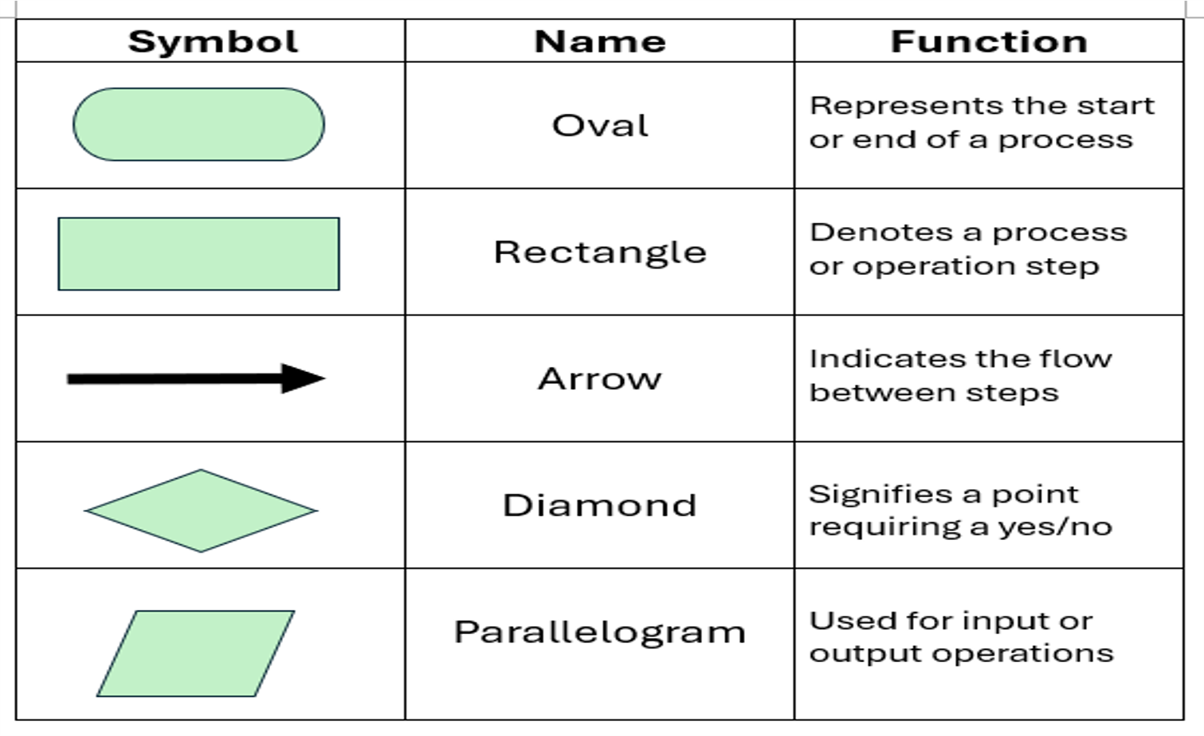
The different symbols used in Flowchart are:-
Decision
making

Slide 32
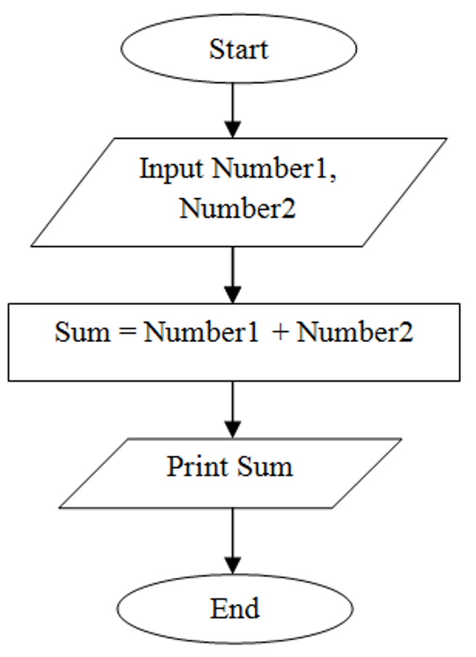
1. Draw a flowchart to find sum of two numbers

Slide 33
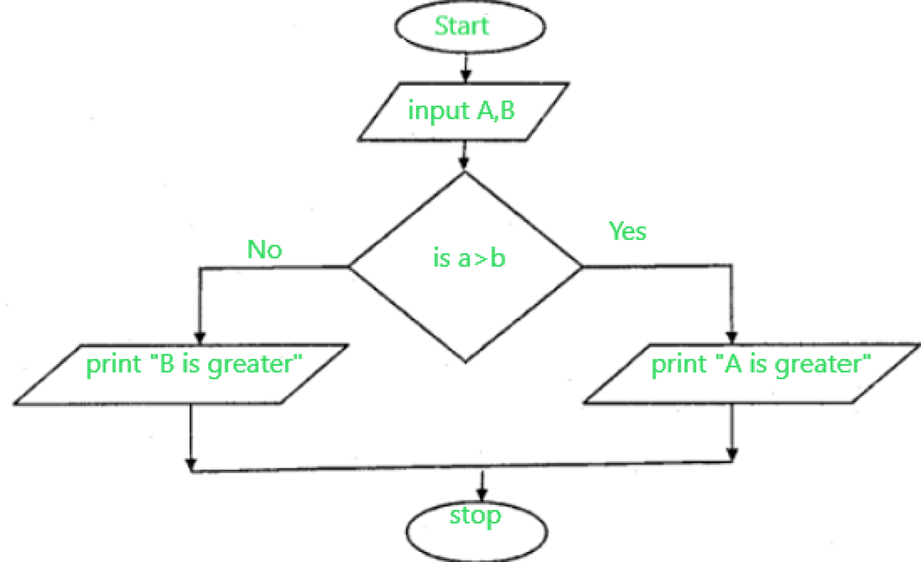
2. Draw a flow chart to find greatest among two.

Slide 34
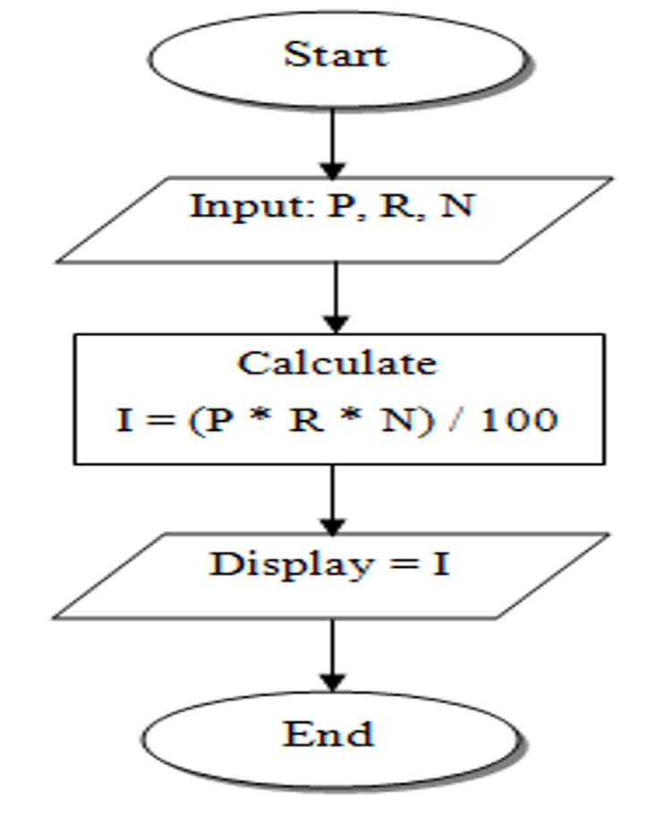
3. Draw a flowchart to find simple interest.

Slide 35
4. Draw a flow chart to find the entered number is even or odd.

Slide 36
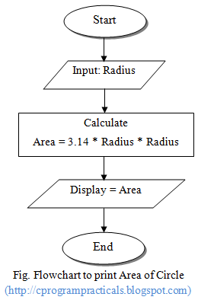
5. Draw a flowchart to find area of circle.

Slide 37
Advantages of flowchart
Improved Understanding:- Flowcharts visually represent processes, making complex workflows easy to understand for both technical and non-technical audiences.
Efficient Problem-Solving:- By breaking down a process into individual steps, flowcharts help identify errors and solve problem.
Easy Modification and Maintenance:- Flowcharts allow for easy updates and modifications when processes or requirements change.
Disadvantages
Time-Consuming:- Designing detailed and accurate flowcharts, especially for complex systems or processes.
Difficulty in Managing Complex Processes

Slide 38
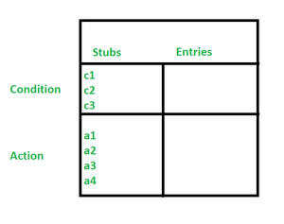
3. Decision Table
It is a tabular method used to represent and analyze complex decision-making processes, particularly used in systems design.
It provides a structured framework to list all possible conditions and corresponding actions to ensure complete coverage of all scenarios.
Decision Tree
It is a decision support tool that uses a tree like graph or model of decisions and their possible consequences.

Slide 39
QN1- Create a decision table for the following conditions and actions. a) Old customer shopping >10k ,10% discount b) Old customer shopping less <10k , 5% discount. c) New customer shopping> 10k, 3% discount d) New customer shopping <10 k ,0%discount.

Slide 40
QN-2 "Construct a decision table to describe the organizational salary increment based on the following conditions:
Employees with a salary of 50,000 or more will receive no increment. 2. Employees with a salary between 30,000 and 50,000 will receive a 10% increment. 3. Employees with a salary of less than 30,000 will receive a 15% increment.

Slide 41
QN-3 "Create a decision table to describe the servicing of a car based on the following conditions:
a) Is petrol low? b) Is oil low?
The decision table should account for the four possible combinations of these conditions and specify the corresponding actions:
a) Both petrol and oil are low → Get both petrol and oil.
b) Only petrol is low → Get petrol only. c) Only oil is low → Get oil only.
d) Neither is low → Do not get anything.

Slide 42
QN-4 Create a decision table to determine the eligibility of students for a scholarship based on their academic performance and financial need. Consider the following conditions:
GPA>=3.70 and annual family income is low(<$30,000) provides 100% scholarship.
GPA>=3.70 and annual family income is Moderate($30,00- $60,000) provides 75% scholarship.
GPA>=3.70 and annual family income is high (>$60,000) provides 50% scholarship.
GPA>=3.50 and annual family income is low (<$30,000) provides 75% scholarship.
GPA>=3.50 and annual family income is moderate ($30,00- $60,000) provides 50% scholarship.
For other cases there is no scholarship.

Slide 43
QN-5 "Create a decision table to check the admission criteria for BCA program at Pokhara University based on the following conditions:
a) The applicant must have completed +2 with minimum of 45%, admit the student
b) Should be from science or management, admit the student
c) Has/she should have passed grade 11 but failed in 1 subject in 12(chance exam given), admit with condition

Slide 44
assignment Write down the major advantages and disadvantages of decision table.

Slide 45
Presentation on Program Development Life Cycle Roll- no 1-23(Friday) Roll-no 24 above(Tuesday)

Slide 46
Thank you..

